Slide 1
Word Power Hour
Debbie Foster & Danielle DavisRoe

Slide 2
Word Power Hour: Top 10 Tips & Tricks
Fix Settings
Default Document Font
Paragraph Formatting
Default Formatting
Section Breaks
Page Numbering
Viewing Documents
Keyboard Shortcuts
Quick Parts
Quick Access Toolbar

Slide 3
1: Fix Settings

Slide 4
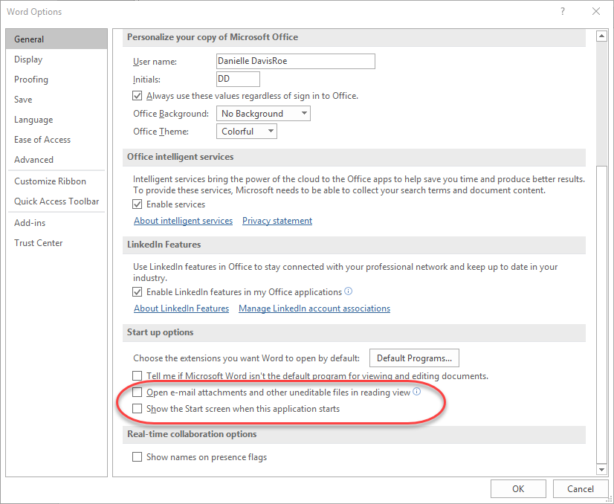
1: Fix Settings - General

Slide 5
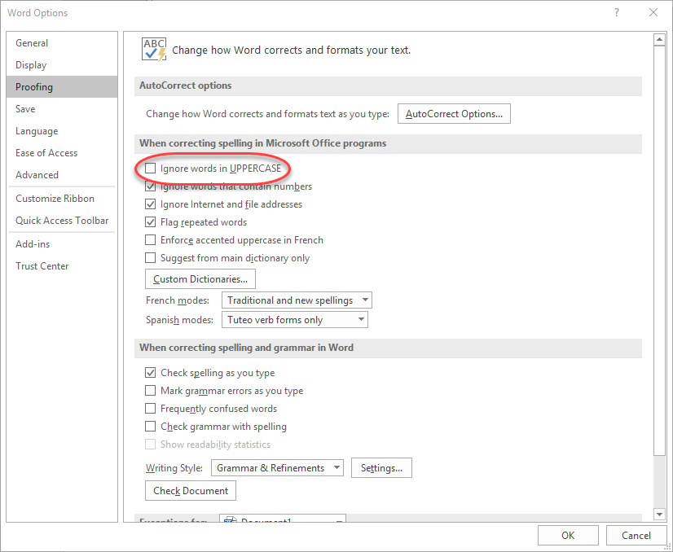
1: Fix Settings – Spell Check

Slide 6
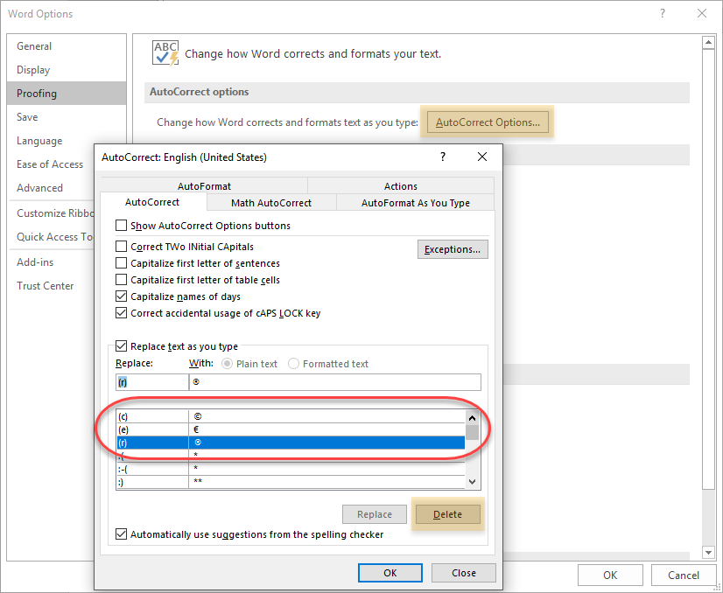
1: Fix Settings – AutoCorrect

Slide 7
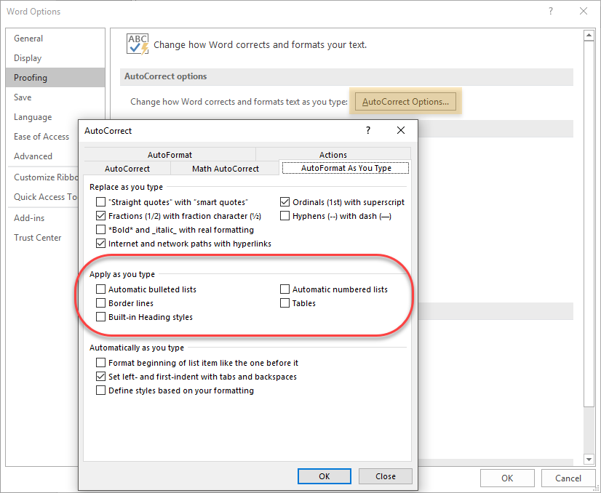
1: Fix Settings – AutoFormat

Slide 8
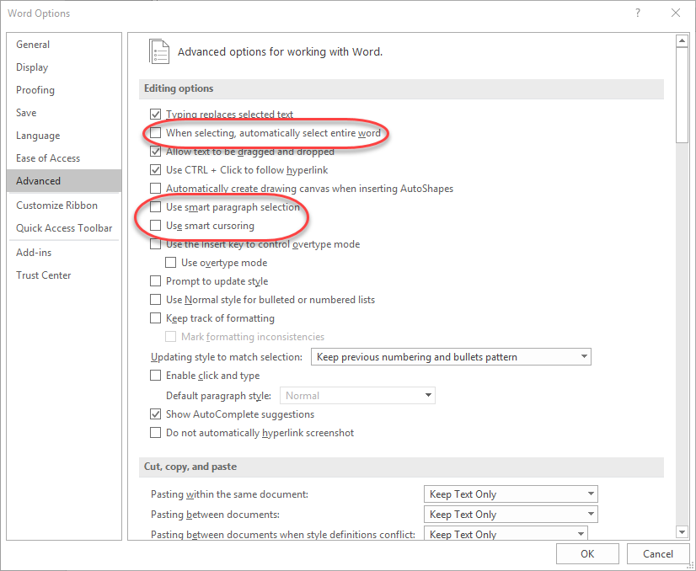
1: Fix Settings – Selecting Text

Slide 9
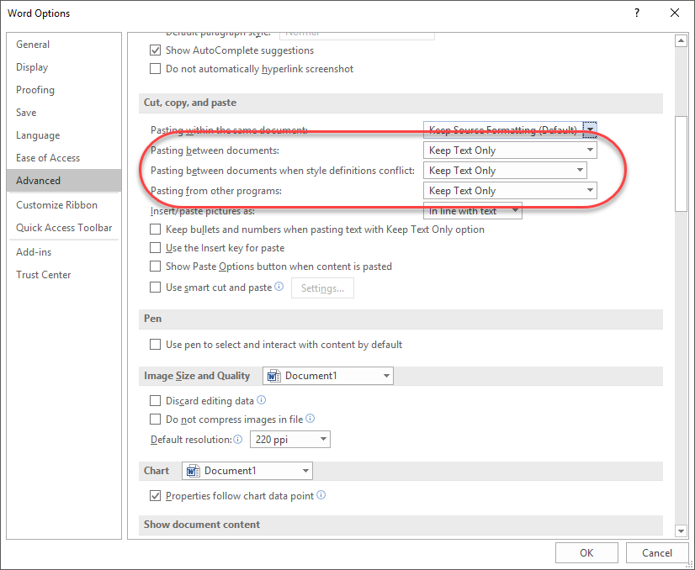
1: Fix Settings – Default Paste

Slide 10
2: Default Document Font
Notes:
Fix the default font for any document

Slide 11
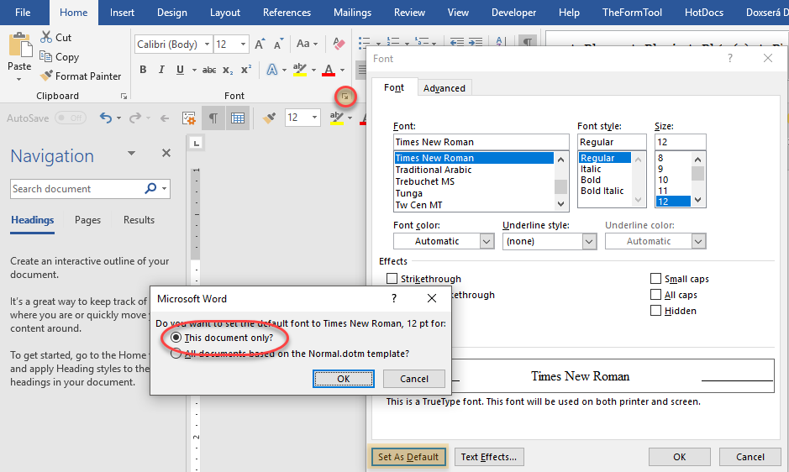
2: Default Document Font

Slide 12
3: PARAGRAPH FORMATTING

Slide 13
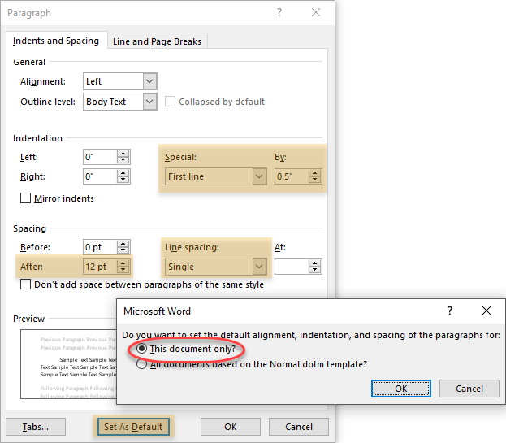
3: Paragraph Formatting

Slide 14
4: Default Formatting
Notes:
Fix formatting for blank documents (Normal.dotm)

Slide 15
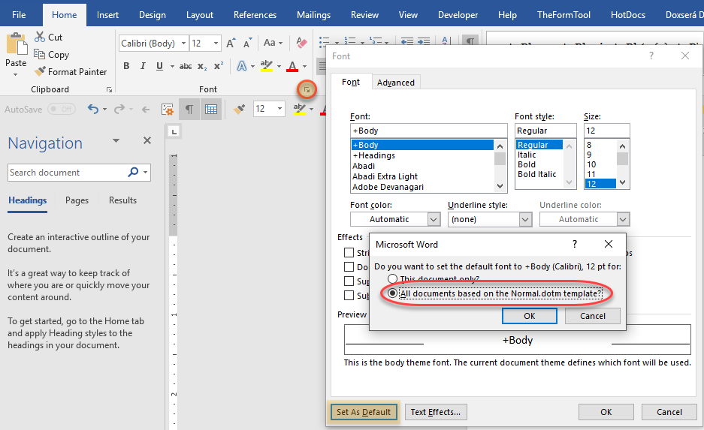
4: Default Formatting - Font
Notes:
Fix font and paragraph settings for Normal template

Slide 16
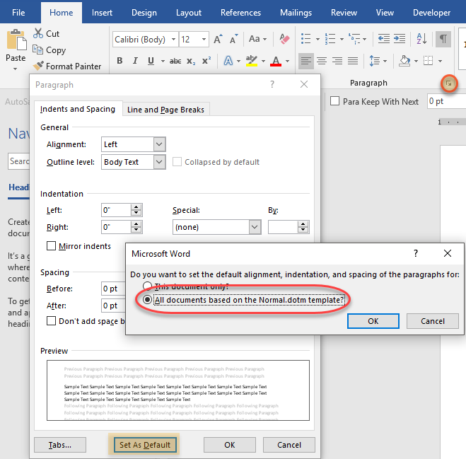
4: Default Formatting - Paragraph
Notes:
Fix font and paragraph settings for Normal template

Slide 17
5: Section Breaks

Slide 18
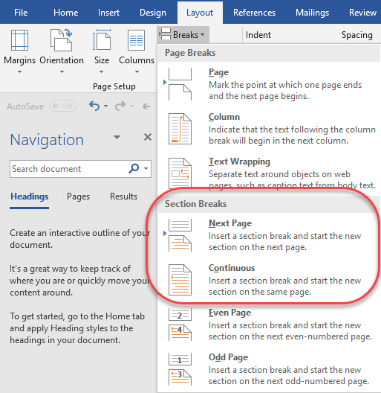
5: Section Breaks - Why
Notes:
used to change page formatting:
size
orientation
headers & footers
margins
examples:
different page numbering
different top margin on first page

Slide 19
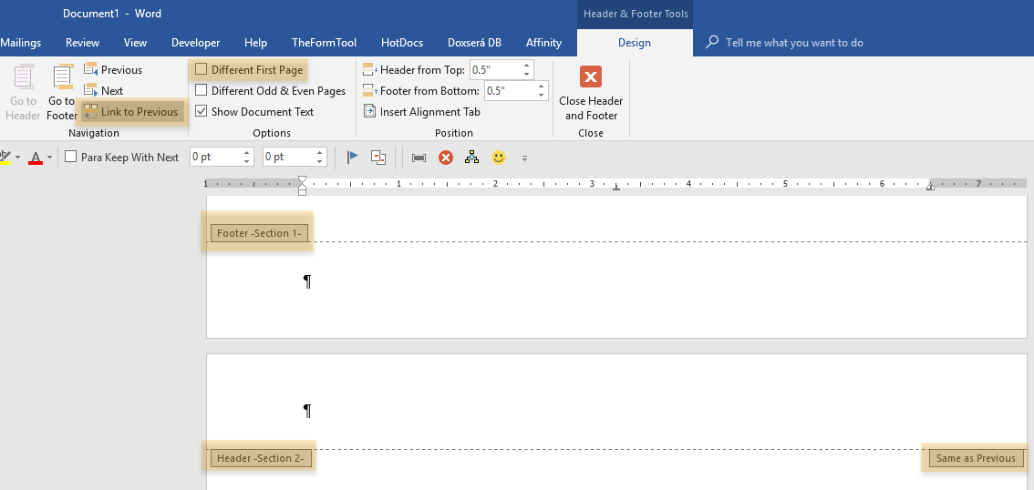
5: Section Breaks – Headers and Footers
Notes:
4 headers & footers per section:
default
first page
odd
even
cut the link to change between sections

Slide 20
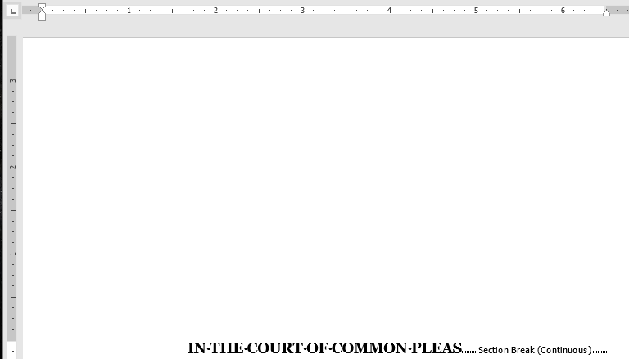
5: Section Breaks – Different Top Margin
Notes:
Continuous section break – different margin on either side of it

Slide 21
6: Page Numbering

Slide 22
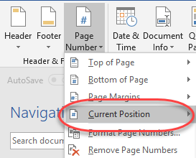
6: Page Numbering – Current Position

Slide 23
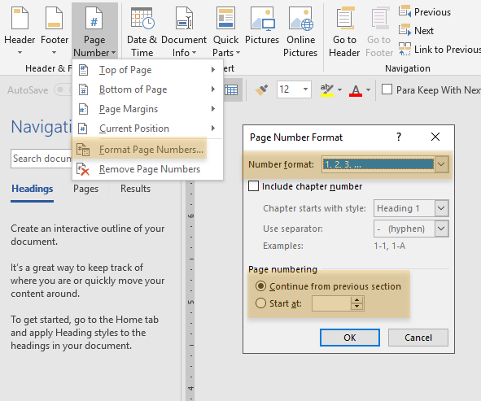
6: Page Numbering - Formatting

Slide 24
7: Viewing Documents

Slide 25
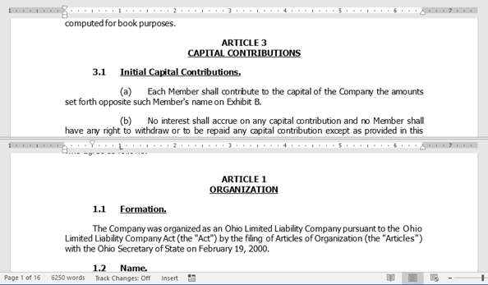
7: Viewing Documents – Split Pane
Notes:
View two parts of the document at once – in one window

Slide 26
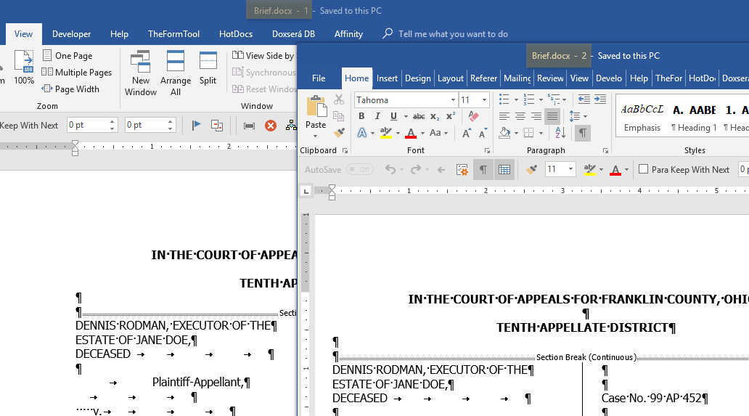
7: Viewing Documents – New Window
Notes:
view two parts of the same document in different windows

Slide 27
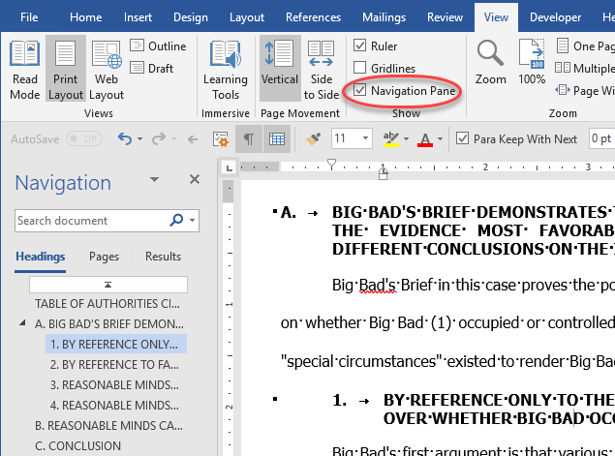
7: Viewing Documents: Navigation Pane
Notes:
Living TOC – if styled correctly

Slide 28
8: Keyboard Shorcuts

Slide 29
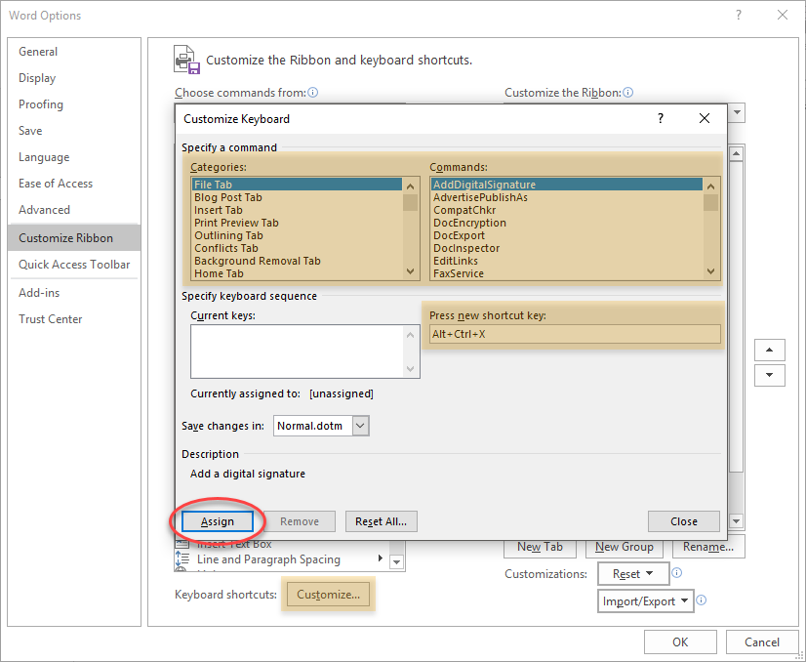
8: Keyboard Shortcuts

Slide 30
9: Quick Parts

Slide 31
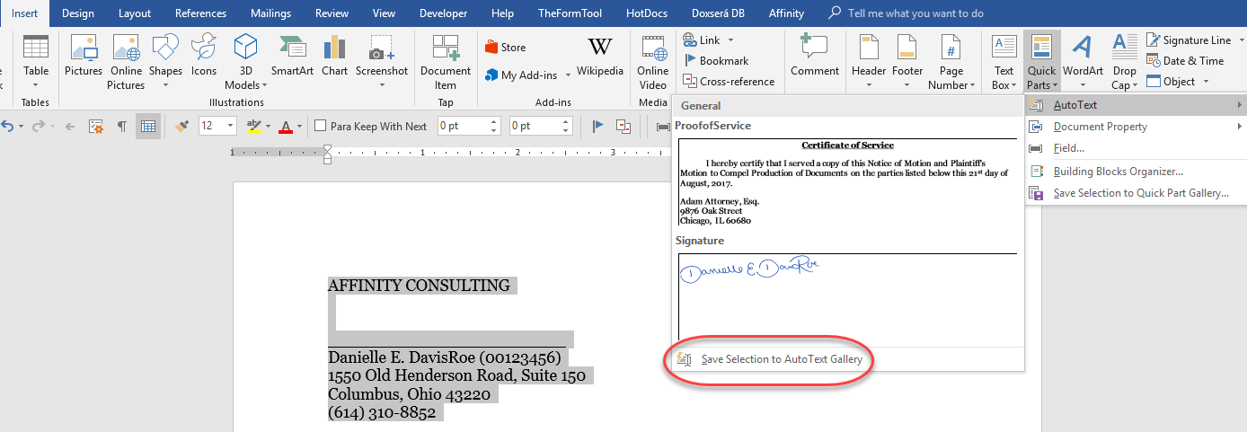
9: Quick Parts – AutoText Setup

Slide 32
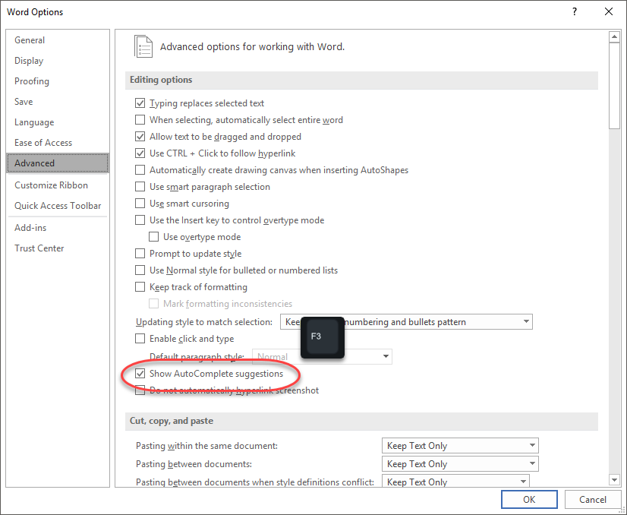
9: Quick Parts – AutoText Completion
Notes:
Reason to use AutoText – start typing name & hit F3 to insert

Slide 33
10: Quick Access Toolbar

Slide 34
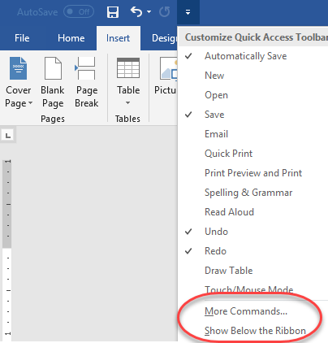
10: Quick Access Toolbar
Notes:
Show below ribbon
right click to add more
more commands to add others

Slide 35
Questions?
Name: Danielle DavisRoe | Email: ddavisroe@affinityconsulting.com

