Slide 1
Amplifying Your i-Q
(Innovation Quotient)
Dr. Michael Brenner
President
Right Chord Leadership

Slide 2
The following presentation contains video and audio. Please be mindful of your device’s volume if others are in the area.

Slide 3
We help leaders and teams at all levels…
Leadership & team development
Consulting
Executive coaching
Keynotes
Train the trainer
Retreats & Offsites
Online training
Find their groove
Get in sync
Work in harmony
“When people work in harmony, great things happen!”
®Copyright 2017 Right Chord Leadership LLC

Slide 4
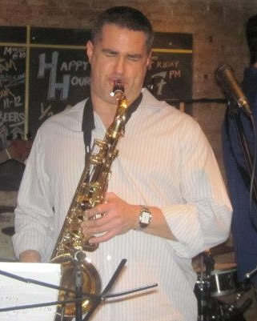
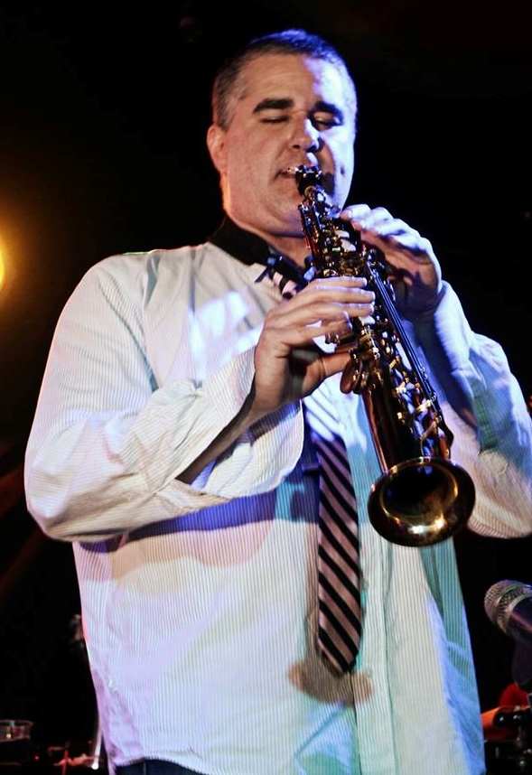
®Copyright 2017 Right Chord Leadership LLC

Slide 5
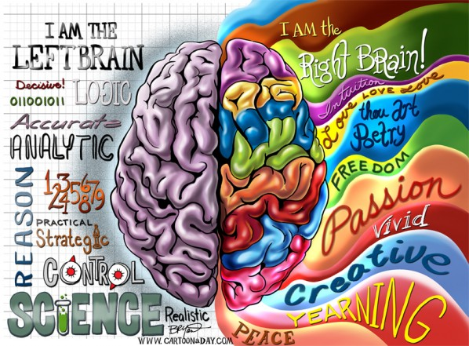
®Copyright 2017 Right Chord Leadership LLC

Slide 6
A Lay of the Land
What is Innovation Quotient (i-Q)?
Why Should Law Firms Care?
Why are Law Firms Traditionally Averse to Innovation?
Introduction to Design Thinking
All That Jazz: Learning from Improvisation
Case Study: Putting it All Together
®Copyright 2016 Right Chord Leadership LLC

Slide 7
A Lay of the Land

Slide 8
“In our time we have released a totally new social force, a stream of change so accelerated that it influences our sense of time, revolutionizes the tempo of daily life, and affects the very way we feel the world around us.”
~ Ken Robinson
Out of our Minds, p. 46

Slide 9
Business
Science
Technology
Zoology
Agriculture
Law
Architecture
Communications
Public Health
®Copyright 2017 Right Chord Leadership LLC

Slide 10
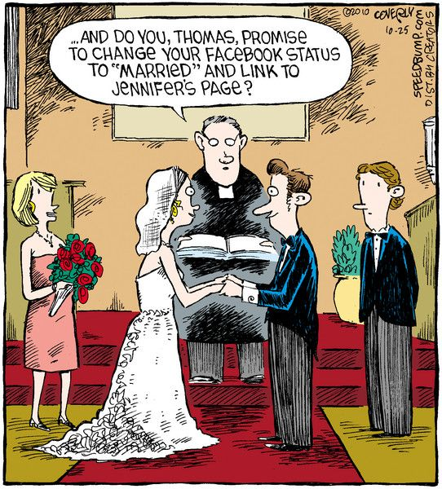
®Copyright 2017 Right Chord Leadership LLC

Slide 11
®Copyright 2017 Right Chord Leadership LLC

Slide 12
Only 4,793 days to retirement…
Must…work…on…resume…
This place sucks my will to live…
®Copyright 2017 Right Chord Leadership LLC

Slide 13
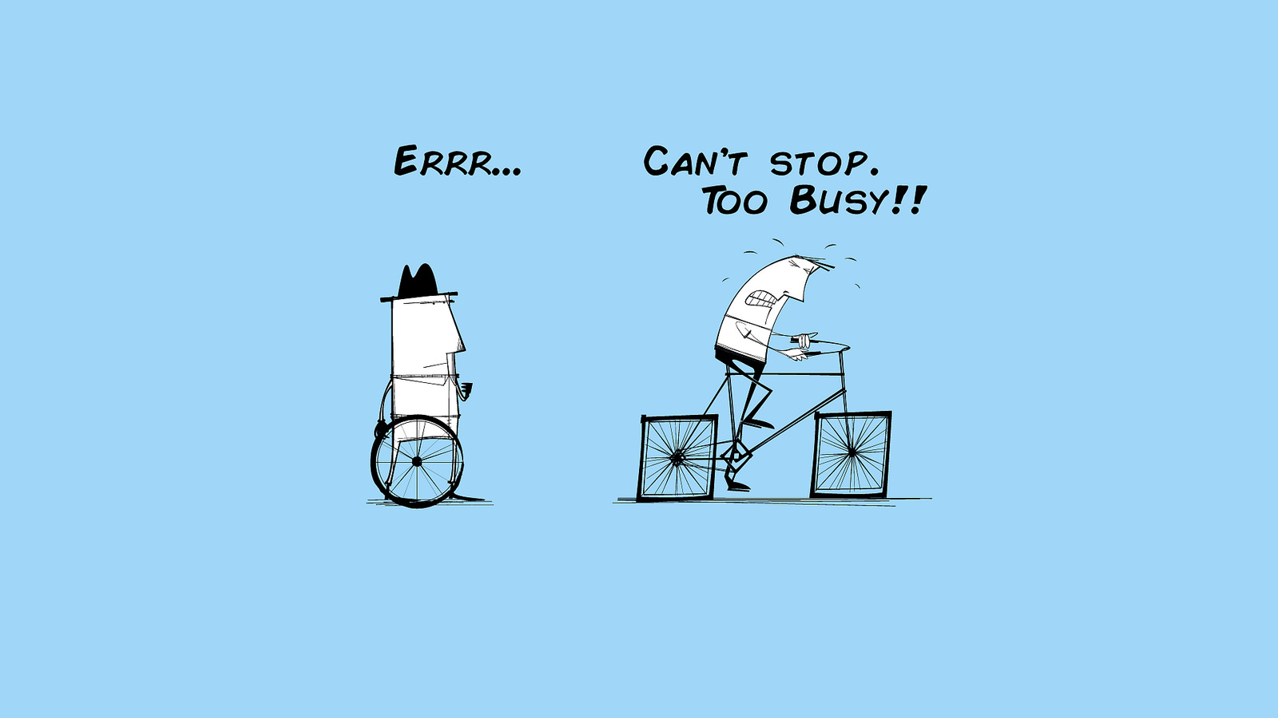
®Copyright 2017 Right Chord Leadership LLC

Slide 14
What is i-Q (Innovation Quotient)?

Slide 15
Innovation Quotient (i-Q) is a measure of one’s capacity to generate, champion, and successfully execute on innovative solutions.
It entails a willingness to challenge the status quo, explore new possibilities, and occasionally fail in the pursuit of progress.
i-Q is not associated with a specific role, position, or function. Each of us possesses an i-Q as well as the ability to amplify it through focused, courageous effort.
®Copyright 2017 Right Chord Leadership LLC

Slide 16
Why should law firms care?

Slide 17
®Copyright 2017 Right Chord Leadership LLC

Slide 18
Lean, agile, low-overhead, highly skilled legal teams to address clients’ needs quicker
Using social media in new ways to attract prospects
Leveraging new technologies such as cloud-based computing and storage systems, workflow apps, and data analytics to improve efficiencies
Providing alternative pricing strategies that offer greater value and benefits to clients
®Copyright 2017 Right Chord Leadership LLC

Slide 19
“Law firms will become emboldened, impatient, highly strategic, and desperate as the more aggressive law firms make ever-bolder moves on the market.”
“Radical, Crazy and Off-the-Rails Moves to Expect from Law Firms” (BTI Consulting)

Slide 20
Why are law firms traditionally reluctant to innovatE?

Slide 21
Lawyers like precedent
Lawyers are risk averse
Lawyers are pressed for time
Lawyers are trained to find “holes” in arguments

Slide 22
“OMG a fossil!”

Slide 23
2 Critical Tools for Cranking Up Your i-Q
®Copyright 2017 Right Chord Leadership LLC

Slide 24
Part 1: Design Thinking in a Nutshell
®Copyright 2017 Right Chord Leadership LLC

Slide 25
What is Design Thinking?
Design Thinking is an iterative process whereby we seek to understand the end user, challenge assumptions, and redefine problems in order to identify solutions that might not be immediately apparent.
®Copyright 2017 Right Chord Leadership LLC

Slide 26
“Design thinking can help foster new ideas on improving your firm culture, innovating new billing methods and alternatives to the billable hour that would be more profitable and favorable to your clients, and coming up with marketing ideas for your firm—all of which would benefit your firm and clients, and set you apart.”
“5 Ways to Increase Innovation in Law Firms”
http://blog.meruscase.com/5-ways-to-increase-innovation-in-law-firms

Slide 27
The Process
Define
Ideate
Refine
Execute
®Copyright 2017 Right Chord Leadership LLC

Slide 28
1. DEFINE THE PROBLEM
What’s the real problem? What filters have you been viewing it through?
®Copyright 2017 Right Chord Leadership LLC

Slide 29
2. IDEATE
Unleash your imagination and the power of “What if…?”
®Copyright 2017 Right Chord Leadership LLC

Slide 30
3. REFINE
Determine what’s feasible. Include timelines and resources.
®Copyright 2017 Right Chord Leadership LLC

Slide 31
4. EXECUTE
Seek feedback. Adjust. Fail fast.
®Copyright 2017 Right Chord Leadership LLC

Slide 32
Lather. Rinse. Repeat.
®Copyright 2017 Right Chord Leadership LLC

Slide 33
®Copyright 2017 Right Chord Leadership LLC

Slide 35
10 Rules
Guaranteed to
“Jazz Up” Your

Slide 36
1. Listen with an open mind.

Slide 37
2. Think it…say it!

Slide 38
3. Keep it simple.

Slide 39
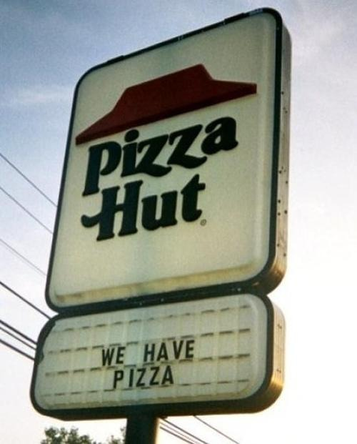
4. Push beyond the obvious.

Slide 40
5. No idea is too outrageous.

Slide 41
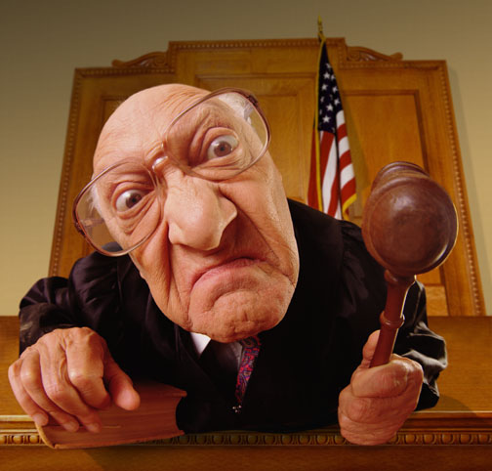
6. No judgment…yet.

Slide 42
7. Piggyback on ideas.

Slide 43
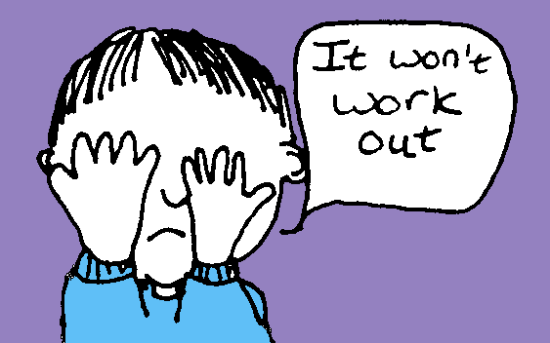
8. No negative energy.

Slide 44
9. Write it all down.

Slide 45
10. Relax, play, have fun!

Slide 46
IDEO Video

Slide 47
What To Do When You Get Stuck?
Ask “disorienting” questions!

Slide 48
What can be added?
What else is like this?
What can be substituted?
What should be subtracted?
What can be combined?
What metaphor
describes this?
What might be adapted?
What could be rearranged?
What might be modified?
What could be put to
another use?
What’s the opposite of this?
Source: Imagineering by Michael LeBoeuf

Slide 49
What can be combined?
What should be subtracted?
What can be added?
®Copyright 2016 Right Chord Leadership LLC

Slide 50
Ask:
“What could we do if resources weren’t an issue?”
Killer Innovation-Boosting Question!
®Copyright 2017 Right Chord Leadership LLC

Slide 51
The Great Hot Dog Dilemma
®Copyright 2017 Right Chord Leadership LLC

Slide 52
“No parents can watch all of their kids 100% of the time,” Dr. Gary Smith says. “The best way to protect kids is to design these risks out of existence.”
Though Smith says he doesn't know exactly how someone would re-design a hot dog, he's certain that some savvy inventor will find a way.

Slide 53
Rearrange
Reconstruct
Reorganize
Recalibrate
Redistribute
Rethink
Reimagine
Reposition
revise

Slide 54
All that Jazz: Lessons in Innovation from Jazz Improvisation
®Copyright 2017 Right Chord Leadership LLC

Slide 55
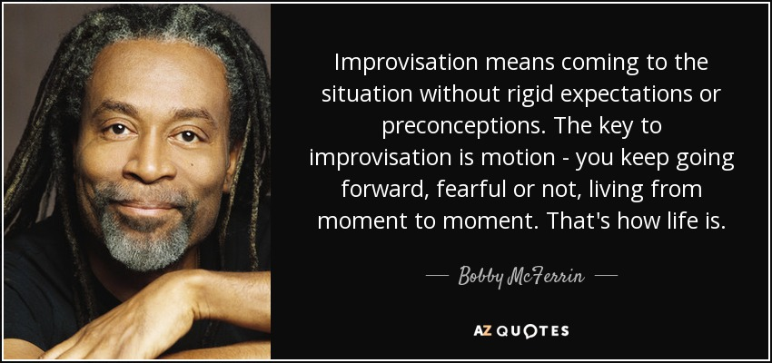

Slide 57
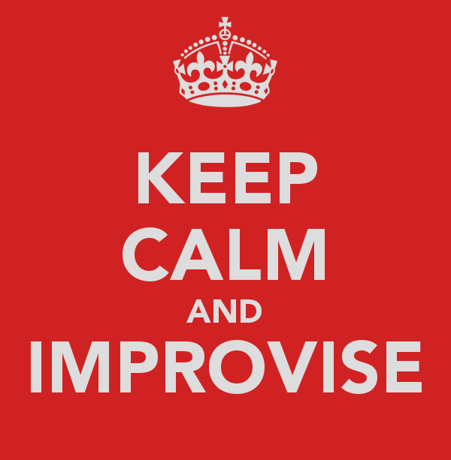
Strengthening your improvisational capacity dramatically improves many critical skills necessary for innovation.
Notes:
Developing Creative High Perf Orgs
EW Stein 2006-2007
57

Slide 58
1
Accept the Offer:
Resist the Pull of the Familiar
®Copyright 2016 Right Chord Leadership LLC

Slide 59
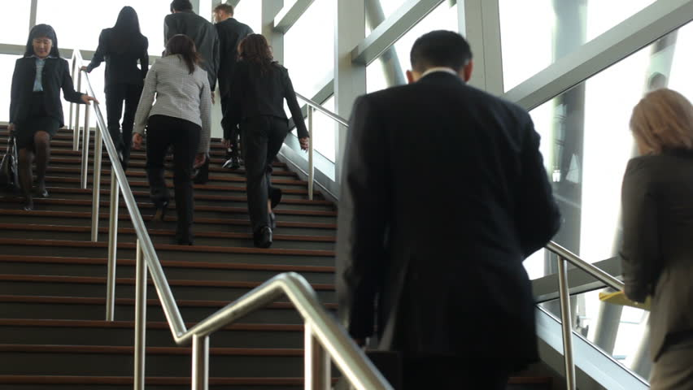

Slide 60
“You like painting?
Me too!”

Slide 61
“You like single malt scotch?
Me too!”

Slide 62
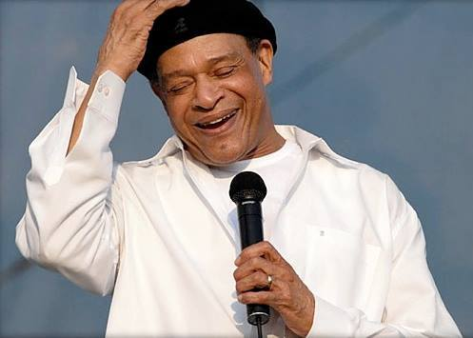
The “Al Jarreau” Principle
The late singer Al Jarreau prided himself on his “jazz attitude,” which he defined as “the idea of being open to each and every moment as a chance to create something different.”
“I try to be receptive and to be listening, and to not be afraid to try something new.”
®Copyright 2018 Right Chord Leadership LLC

Slide 63
“Killer phrases” kill ideas dead.
Motivation
Morale
Trust
Engagement
Energy
Enthusiasm
Joy
®Copyright 2017 Right Chord Leadership LLC

Slide 64
“Who the $#@! wants to hear actors talk?”
- Harry M. Warner - Warner Brothers Pictures, c. 1927
“We don’t like their sound and guitar music is on the way out.”
- Decca Recording Company executive turning down the Beatles in 1962
“There is no reason anyone would want a computer in their home.”
- Ken Olson, president, chairman and founder of Digital Equipment Corp., 1977
“There will never be a bigger plane built.”
- A Boeing engineer, after the first flight of the 247, a twin engine plane that holds ten people
®Copyright 2016 Right Chord Leadership LLC

Slide 65
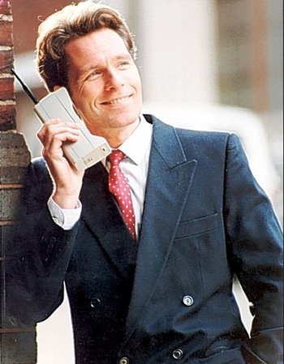
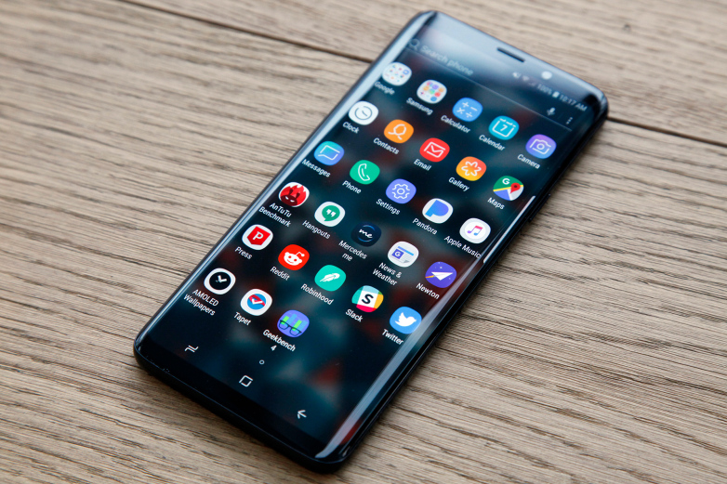
®Copyright 2016 Right Chord Leadership LLC

Slide 66
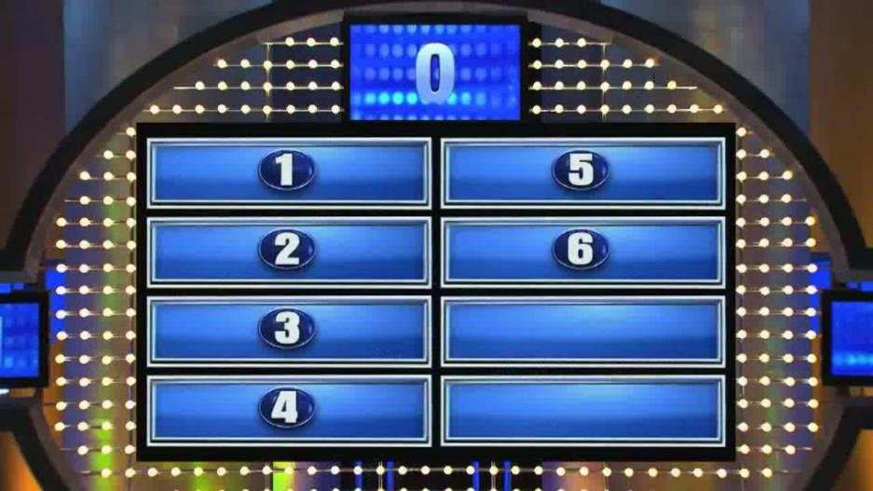
“Puh-leeze…”
“It’s not in the budget.”
“Let’s get a committee to look into it.”
“They’ll never go for it.”
“We tried that once before.”
“That’s how we’ve always done it here.”
“Interesting but now’s not the right time.”

Slide 67
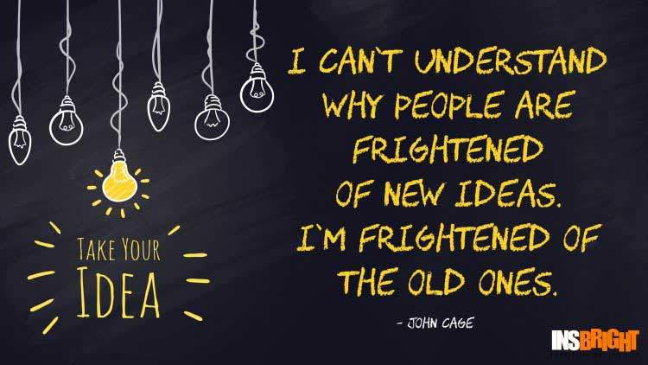

Slide 68
2
Take Risks:
Reframe Mistakes and “Failure”
®Copyright 2016 Right Chord Leadership LLC

Slide 70
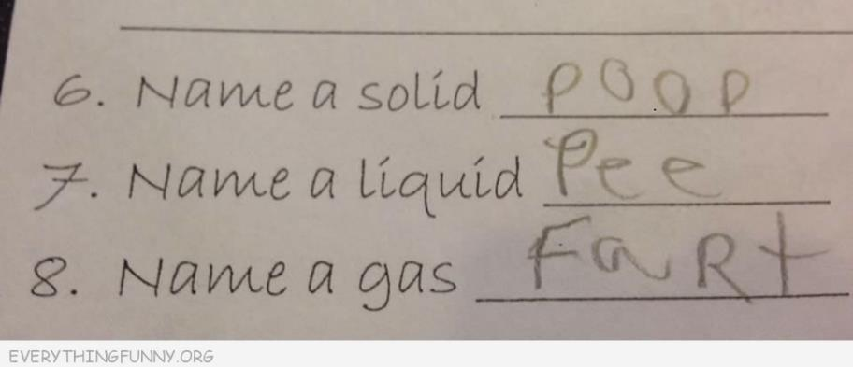
X
X
X

Slide 71
Who’s to blame?
Who dropped the ball?
Who screwed up?
Who’s responsible for this mess?
Whose fault is it?
Who blew it?
Why won’t they give me what I need?
Why can’t they do it right?
What is wrong with them?
®Copyright 2017 Right Chord Leadership LLC

Slide 72
Herbie Video

Slide 74
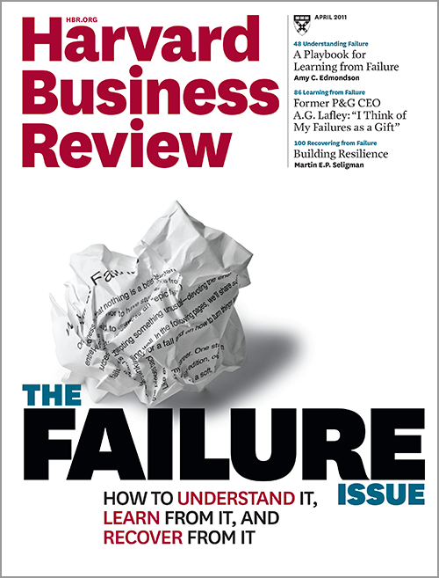
®Copyright 2016 Right Chord Leadership LLC

Slide 75
Easy as 1…2…3
1. Determine areas of the business where mistakes cannot be tolerated and where a mistake could occur without causing too much damage.
2. Communicate that making any mistake once is OK, as long as it is an honest mistake made while attempting to do something innovative. However, repeating that same mistake is NOT OK.
3. Coach people to learn from mistakes, own them, fix them, and put safeguards in place to ensure they won’t be repeated.
Source: “Good Employees Make Mistakes. Great Leaders Allow Them To” by Amy Rees Anderson, Forbes.com

Slide 77
2018
Your firm

Slide 78
High Potential Innovation Projects
Client portals for select, strategic clients
Microsite proposals
Create a Client Advisory Board
Implement a CLE-style training program for the Marketing Department
“Welcome” package for new clients
Make website a “smart” website
Master experience database

Slide 79
Named in all four ranking categories:
Movers & Shakers: Ranks among the top 25 percent of U.S. law firms that are “making bold moves which are strategically and tactically impressive.”
Innovation Builder: Recognized as being among the first to try new approaches and embrace new ways of thinking about client issues.
Client Experience Innovator: Commended for delivering a high level of service across teams, practice, and offices; understanding matter-specific risks; proactively bringing industry-specific insight to clients; and using leading edge technology and practices to track budget and performance data.
Law Firm Technology Leader: One of only 61 U.S. law firms hailed for its skill in developing, customizing, and using technology to mine data, improve cost efficiency, predict industry trends, share information, and improve quality.

Slide 81
YOU. ROCK!

Slide 82
www.rightchordleadership.com
LinkedIn: Dr. Michael Y. Brenner
michael@rightchordleadership.com
610.724.3621

